Slide 1
Amazon Business Accounts Payable & Invoicing Walkthrough
Notes:
My name is Amanda and I am with Amazon Business.
You have been identified as part of the Account Payable team through your organization and today we will be reviewing the Accounts Payable process.

Slide 2
Table of Contents
Pay by Invoice Setup
Configuring your Pay by Invoice Account, Invoice Templates
Accessing Pay By Invoice (PBI) Account Status and Monitoring your Credit Limit
Tax Policy
Account Reconciliation
Accessing your Invoices
Accessing Invoices in Bulk
Business Analytics for Remittance
Paying Your Invoices
Refunds/Credit Memos/Past Due Balances
Applying Credit Memos
Unapplied Payments & Refunds
Managing Past Due Invoices
Contacting Customer Support
Notes:
I will be reviewing multiple features available to you throughout the presentation. If you would like more information on any feature discussed today, please reach out to your Amazon Business Account Executive. If you are not sure who your Account Executive is, please ask in the chat and we will respond with their information.

Slide 3
Pay by Invoice Setup
Notes:
Pay by Invoice Setup

Slide 4
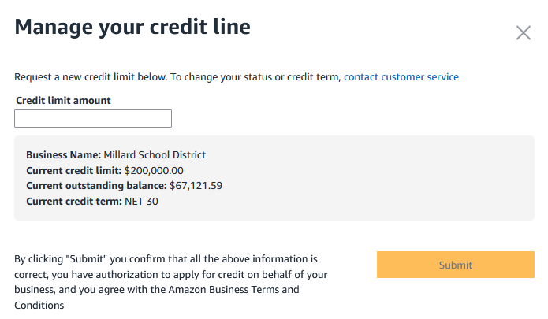
Monitoring Your Credit Limit
Your Available Credit is affected by both your Outstanding Balance AND Pending Charges
Request an Increase
Contact Customer Service directly within your Amazon Business Account OR
Contact your Account Executive
Proactive Usage Increases
Plan ahead!
3 BUSINESS days for requests below $100K
5 BUSINESS days for requests above $100K
Notes:
Monitoring your credit limit:
Your Available Credit is affected by both your Outstanding Balance AND Pending Charges
To Request an Increase there are few options:
First, From “Your invoices for Pay By Invoice” dashboard shown on the image, select “Manage my credit line” enter the total amount you would like on the account and hit submit
Second, Contact Customer Service directly within your Amazon Business Account OR
Last, Contact your Account Executive
Be Proactive monitoring Usage on the account and request Increases in advance
Be aware of peak ordering times within your business, such as back to school, holidays, large events and Plan ahead – If you need to increase your credit limit, make sure you give enough time for Amazon to review and respond to your request.
3 BUSINESS days for requests below $100K
5 BUSINESS days for requests above $100K
If you need assistance reach out to your Account Executive – This is your dedicated Amazon Business representative who will assist with account management of your Amazon Business account. Again, If you are not sure who your Account Executive is, please ask in the chat and we will respond with their information.

Slide 5
Account Reconciliation
Notes:
Account reconciliation

Slide 6
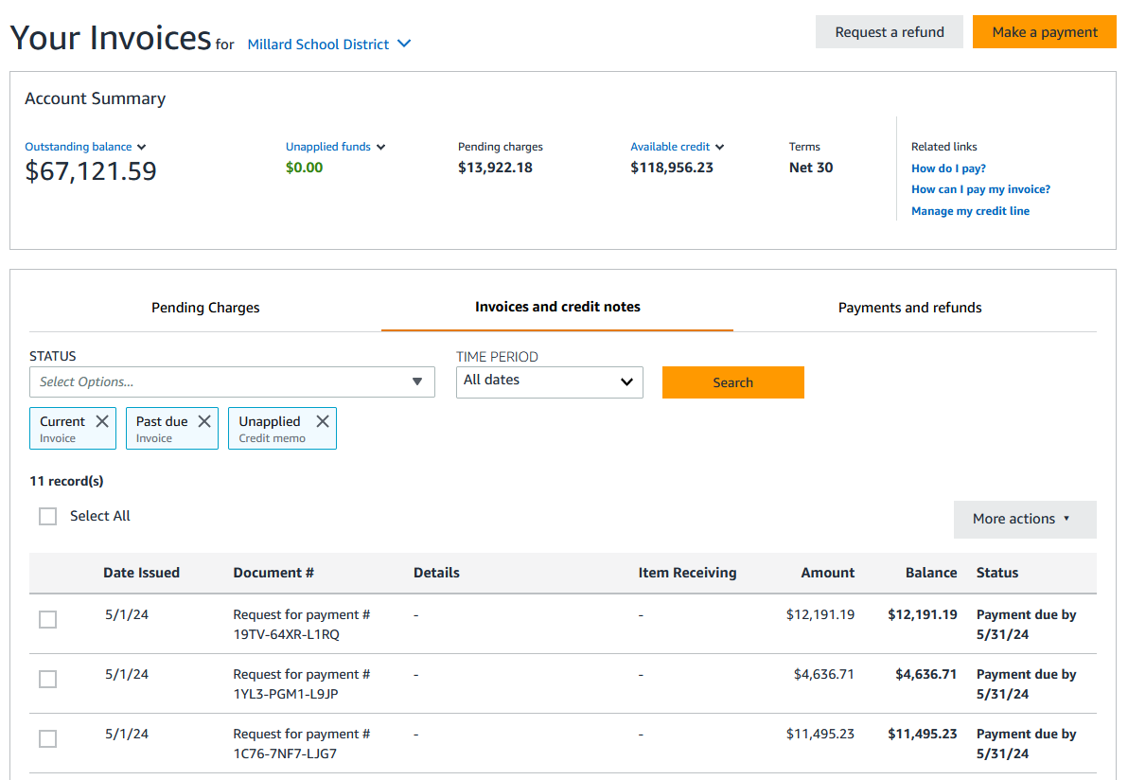
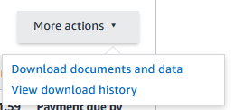
Accessing your Invoices
If you are assigned the Administrator or Financial Administrator role, to access your invoices and account status navigate to:
Business Settings > Billing & shipping > Your Invoices for Pay by Invoice
Review invoices and credit memos or download a list all invoices and/or credit memos by selecting More Actions – Download documents and data
Additional points of access:
Your Orders
Bulk Download from Business Analytics
Notes:
If you are assigned the Administrator or Financial Administrator role, to access your invoices and account status navigate to:
Business Settings > Billing & shipping > Your Invoices for Pay by Invoice
You will see the Summary of the in the “Your Invoices for Pay by Invoice” section. From the dashboard you can
See the status of the account such as outstanding account balance, unapplied payments/credit memos)
Download individual invoices by clicking on the invoice. It will open a PDF
Download CSV of invoices using Generate CSV which will generate a spreadsheet
And Root level Administrator or finance roles can toggle between groups to see their Pay by Invoice summaries and information at each group level

Slide 7
Accessing Invoices in Bulk
If you need to download the PDF for an Invoice, you have the option to download bulk invoices (up to 15 at a time to a ZIP file). You can access these by going to Business Settings → Business Analytics → Reconciliation Report. From here you can download invoices. You can use the Filters to narrow the invoices down to the ones you are looking for.
You can also download your reconciliation report into a CSV file by clicking on “Download CSV”.
Notes:
Access Amazon Business Analytics from the top right drop down menu
Select reports and choose the report you would like to review, such as reconciliation.
Once you are in the reports page, you can:
select a time period
add filters
Adjust the columns that will be downloaded in your report
Download the CSV which will generate a report that you can further review
Group Level Administrators will only see Invoices pertaining to their specific Group(s)
You can also
Get order documents (invoices) and download as a pdf from the reports page.

Slide 8
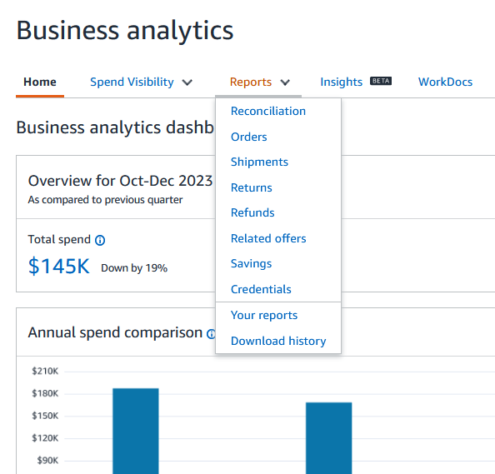
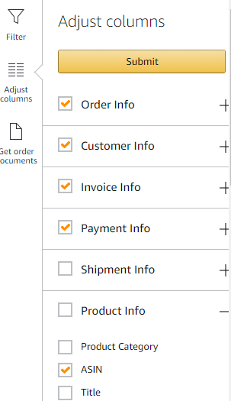
Business Analytics for Remittance
Depending on your reconciliation needs, you can use either the Reconciliation or Orders report to reconcile invoices:
Reconciliation Report: A simple report that shows the Invoice #, Purchase Order, Group, User and Approver (if needed)
Orders Report: This has over 60+ fields of data that can be filtered down to the data you need for entering your invoices into your internal systems
Returns Report: This report shows all Credit Memos that have been generated for your account
Save any report for future use or Download CSV to manipulate the data in an excel file. Download invoices individually or in bulk from Business Analytics.
Notes:
Business Analytics is great for PDF Invoice Customers to download their invoices into a CSV/Excel format
For customers receiving invoices by CXML:
this report isn’t used often due to their internal system receiving the invoices via CXML. however if invoices are Past Due, the Orders Report can show the invoices that are open on their account to help reconcile against their internal system
Depending on your reconciliation needs, you can use either the Reconciliation or Orders report to reconcile invoices:
Reconciliation Report: is A simple report that shows the Invoice #, Purchase Order, Group, User and Approver if you use that feature.
Orders Report: has over 60 fields of data that can be filtered down to the data you need for entering your invoices into your internal systems
And the Returns Report: shows all Credit Memos that have been generated for your account
Save any report for future use or Download CSV to manipulate the data in an excel file. Download invoices individually or in bulk from Amazon Business Analytics.

Slide 9
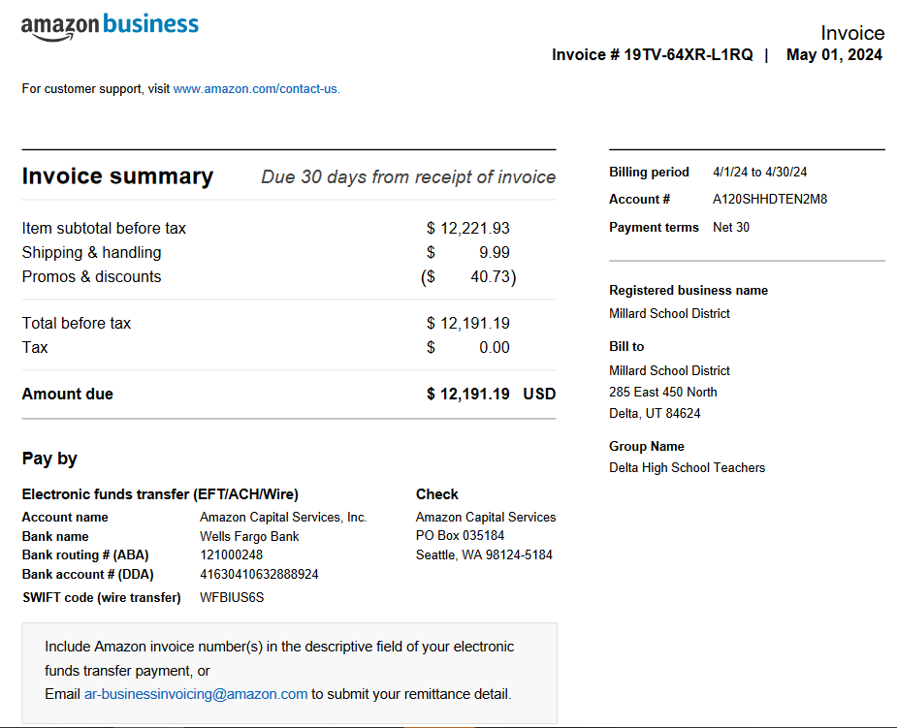
Paying your invoices via ACH/Wire
Configure Amazon Business using the Remit To Information provided on your Invoice or via Your Invoices by Pay by Invoice > Make a Payment > Offline Payment
Email Remittance Details with each payment to ar-businessinvoicing@amazon.com and include the Amazon Invoice #’s you are paying.
Include your Account Number (from the Invoice) and Payment Amount in the Email Subject Line or Email Body
Include how to apply Credit Memos in your Remittance Details
1111222223333344445
Note: All invoices should be paid on or before the NET term. Any orders with returns or issues, such as damaged or missing items, should be resolved through Customer Service and a Credit Memo will be issued as needed that can be applied to the corresponding invoice.
Notes:
If you would like to pay your invoices through ACH or Wire, follow these simple steps:
Configure Amazon Business using the “Remit To” Information provided on your Invoice or through Business Settings > Your Invoices by Pay by Invoice > Make a Payment > Offline Payment
Email Remittance Details with each payment to ar-businessinvoicing@amazon.com and include the Amazon Invoice #’s you are paying.
Include your Account Number (from the Invoice) and Payment Amount in the Email Subject Line or Email Body
Include how to apply Credit Memos in your Remittance Details
Note: All invoices should be paid on or before the NET term. Any orders with returns or issues, such as damaged or missing items, should be resolved through Customer Service and a Credit Memo will be issued as needed that can be applied to the corresponding invoice.

Slide 10
Credit Memos & Past Due Balances
Notes:
Credit Memos and Past Due balances

Slide 11
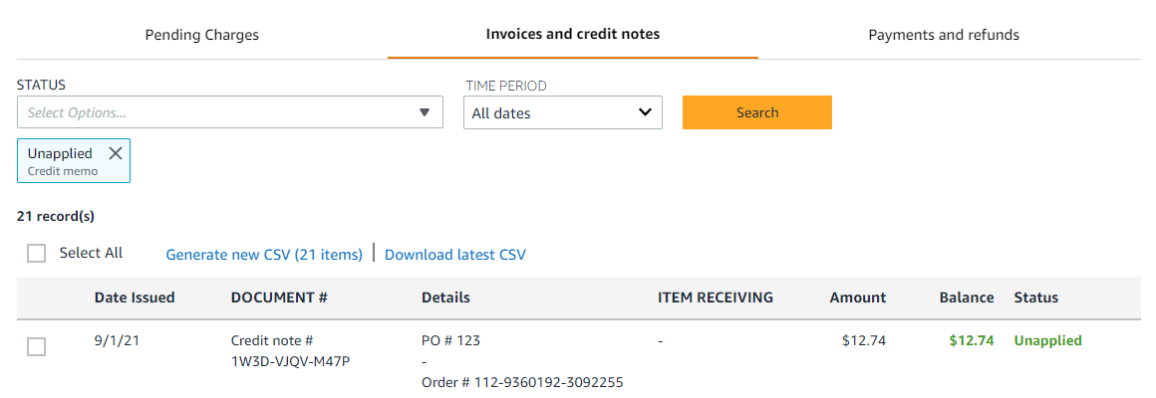
Applying Credit Memos
Unapplied Credits are easily viewable within the “Your Invoices for Pay by Invoice” page:
Example
Credit Memo Use Best Practices:
If a Credit Memo is received before the invoice is paid, you can apply the credit memo to the unpaid invoice. To apply a credit memo to the unpaid invoice, you need to include this on your remittance details.
If a Credit Memo is received after the invoice is paid, you must designate how you want to apply the unapplied credit memos in your remittance details or send to ar-businessinvoicing@amazon.com.
If you have questions on how Credit Memos were applied, please email ar-businessworkbench@amazon.com. Use your Credit Memos in a timely manner. Amazon Business reserves the right to apply credits to invoices that are 30 days past due
Notes:
Unapplied Credits are easily viewable within the “Your Invoices for Pay by Invoice” page
Under Status, select the drop down menu and choose to populate only unapplied credit memos
Credit Memo Use Best Practices:
If a Credit Memo is received before the invoice is paid, you can apply the credit memo to the unpaid invoice. To apply a credit memo to the unpaid invoice, you need to include this on your remittance details.
If a Credit Memo is received after the invoice is paid, you must designate how you want to apply the unapplied credit memos in your remittance details or send in an email to ar-businessinvoicing@amazon.com.
If you have questions on how Credit Memos were applied, please email ar-businessworkbench@amazon.com. Use your Credit Memos in a timely manner. Amazon Business reserves the right to apply credits to invoices that are 30 days or more past due

Slide 12
Unapplied Payments & Refunds
Refunds/Disbursements: You can request a refund back to your bank. If the total value of your unapplied payments and credits exceed your past due balances, you can request a refund up to that total amount through the Your Invoices page. Please note refunds can only be processed in full, it is not possible to receive a partial refund
Unapplied Payments: Amazon will send reminder emails about unapplied payments to Accounts Payable contacts or top level Administrators. Please designate the open invoices that you wish to apply the funds to in an email to ar-businessworkbench@amazon.com.
Example
Example
Notes:
Review Unapplied Payments & Refunds:
Refunds/Disbursements: You can request a refund back to your bank. If the total value of your unapplied payments and credits exceed your past due balances, you can request a refund up to that total amount through the Your Invoices page. Please note refunds can only be processed in full, it is not possible to receive a partial refund
For Unapplied Payments: Amazon will send reminder emails about unapplied payments to the Accounts Payable contacts or top level Administrators. Please designate the open invoices that you wish to apply the funds to in an email to ar-businessinvoicing@amazon.com .
To avoid unapplied funds, ensure remittance details are being submitted in full at time payment is being submitted. If paying by ACH or Wire, submit to ar-businessinvoicing@amazon.com ; if paying by check, include the full detail with the check and/or to ar-businessinvoicing@amazon.com

Slide 13
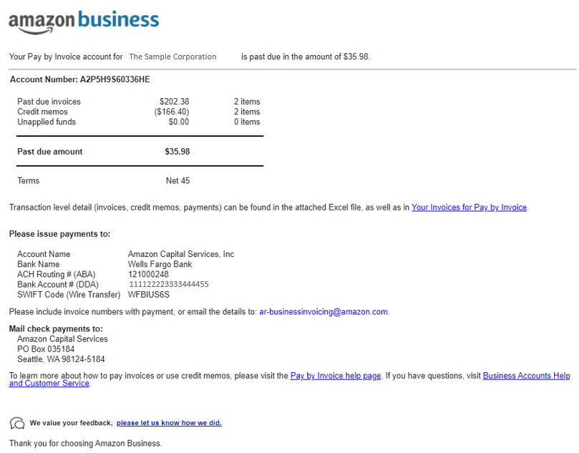
Managing Past Due Invoices
If your account has Past Due Invoices, AP Contacts/Account Admins will receive an email from Amazon’s Global Accounts Receivable team. Below is our recommended process to resolving past due invoices:
Confirm you have received and processed all the unpaid invoices.
If you receive invoices via PDF, download missing PDFs in Business Analytics
If you use Integrated Invoicing, email corporate-punchout@amazon.com and inform them of the missing invoices. You may also download the PDF’s in Business Analytics
Reply to the Past Due/Dunning Email with a summary of your findings
The purpose of this process is to ensure you have all invoices and identify the reason for which they are past due
Make a payment or contact Customer Service regarding any disputes
Example
Notes:
Managing past due invoices:
If your account has Past Due Invoices, Accounts Payable Contacts and/or Account Admins will receive an email from Amazon’s Global Accounts Receivable team.
If a Dunning Email is received, the process is meant to help determine the status of each invoice
If you see status
Rejected: this May happen if the end user reports missing or damaged items. In this instance, please contact Customer Support to have credit memo processed.
Short Paid: An example of this is a Tax Exempt customer who is charged Tax or numbers were transposed on a check payment.
Below is our recommended process to resolving past due invoices:
Confirm you have received and processed all the unpaid invoices.
If you receive invoices via PDF, download missing PDFs in Business Analytics
If you use Integrated Invoicing or cXML invoicing, email corporate-punchout@amazon.com and inform them of the missing invoices. You may also download the PDF’s in Business Analytics
Reply to the Past Due/Dunning Email with a summary of your findings
The purpose of this process is to ensure you have all invoices and identify the reason for which they are past due
And lastly Make a payment or contact Customer Service regarding any disputes

Slide 14
Customer Support
Notes:
Customer Support

Slide 15
Common Support Questions
See below for quick resolutions to frequently asked questions as well as contact information for a variety of support resources
Contact Business Customer Support: For questions related to disputed invoices – such as not received or damaged items, or making a return please contact Customer Service via the ‘Help’ link at the bottom of the Amazon Business website and click to ‘Contact us’ or access HERE or call Call 866.486.236 directly.
Amazon Global Accounts Receivable: For questions related to unapplied funds or past due invoices please contact Accounts Receivable via ar-businessworkbench@amazon.com.
Your Account Executive: This person is your point of contact for anything related to the Amazon Business. Your Account Executive can escalate invoicing issues if they are not being resolved in a timely manner.
Configuration Assistance: Amazon Business can provide configuration assistance and change management support. Contact your Account Executive.
Notes:
Common Support Questions:
Contact Business Customer Support: For questions related to disputed invoices – such as not received or damaged items, or making a return please contact Customer Service via the ‘Help’ link at the bottom of the Amazon Business website and click ‘Contact us’ to begin a chat or initiate a phone call.
Amazon Global Accounts Receivable: For questions related to unapplied funds or past due invoices please contact Accounts Receivable via ar-businessworkbench@amazon.com.
Punchout Customer Support: Contact corporate-punchout@amazon.com regarding questions around Halted Orders or your CXML Invoicing feed stops working
Your Account Executive: This person is your point of contact for anything related to the Amazon Business Account. After you have reached out to Customer Support, if you have not received a resolution in a timely manner, Your Account Executive can escalate invoicing issues. If you are not sure who your Account Executive is, please ask in the chat and we will respond with their information.
Configuration Assistance: Amazon Business can provide configuration assistance and change management support. Contact your Account Executive if you would like to get more information on configuration assistance.

Slide 16
Thank You
Notes:
Again, please ask all questions in the chat and it will be answered by email. Thank you for taking the time to review the Accounts Payable and Invoicing Walkthrough training.

