Slide 1
Administrator Debrief Presentation

Slide 2
Table of Contents
Your Account Structure
Business Account Navigation
    Individual/Shared Settings
    Business Order Information
    Delivery Preferences
    Business Lists
Members
    Amazon Mobile App
    Single Sign On (SSO)
    User List Download
    Buying Policies
      Your Buying Policies
      Tax Exemption
      Approvals
Amazon Business Analytics & Spend Visibility
Your Orders / Customer Support
Supplemental Documentation
Notes:
Topics Discussed, Contents, Table of Contents, Areas of Focus

Slide 3
Business Account Navigation
Support Videos [CLICK HERE]
Group management video (including shared/individual settings)

Slide 4


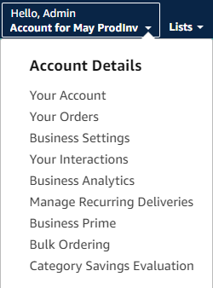
Business Account Navigation
Page | Functionality
Your Account | Standard Amazon account information
Business Settings | Business Management pages. Add users, set up groups, configure buying policies, etc.
Approve Orders | If workflow approvals are enabled, approvers can view and take action on pending orders
Your Orders | View and track your orders. Administrations can view orders others have placed on behalf of the organization
Manage Suppliers | Easily find suppliers on Amazon Business and add them to your list of Saved Suppliers. Learn more.
Business Analytics | Create and filter custom reports based on your business needs to view your organization’s orders
Recurring Deliveries | Have essential items delivered automatically, based on a schedule you choose. Learn More.

Slide 5
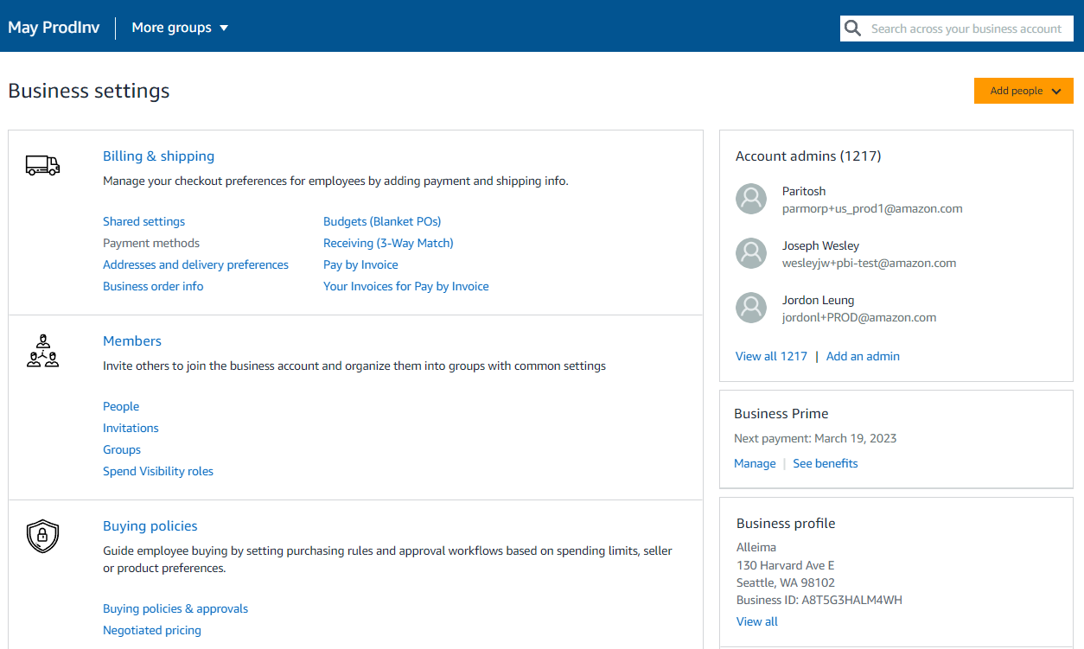
Business Settings
Amazon Business Administrators have the ability to add and remove users, update payment methods, create or edit order & buying policies, and more within the “Business Settings” page.

Slide 6
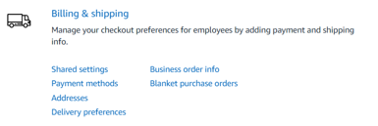
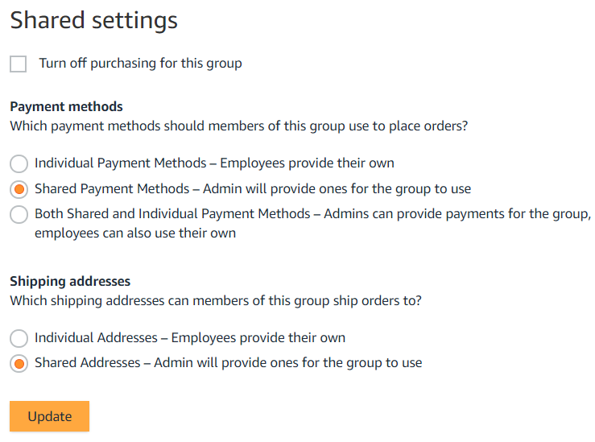
Individual/Shared Payment & Shipping Settings
Administrators can configure at the group level whether Payment Methods and Shipping Addresses will be shared and managed by an Administrator or Individual and managed by the end user.
Considerations
Individual:
End users enter and store addresses during initial setup or checkout
Administrators use analytics reports to audit shipping locations
Shared:
  Administrators enter addresses for each group manually or with an upload spreadsheet
  End users can only ship to addresses shared with their group by an Administrator
  End users will have an option to add their name in the “deliver to” field
Shared and Individual (Payment Only):
Administrators can provide payment and end users can also use their own in the same group
Note: Shared settings will default to Both Shared & Individual for Payment Methods and Individual Addresses. Ensure you configure Shared Settings for any newly created group(s).

Slide 7
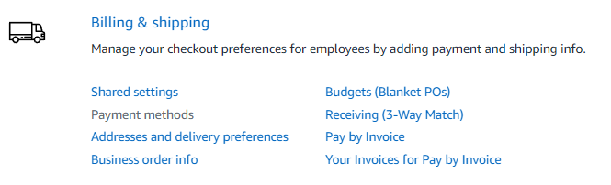
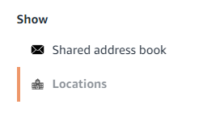
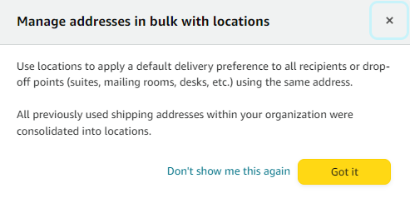
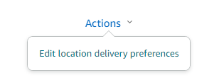
Delivery Preferences
Customize delivery days and times to ensure your packages are delivered when someone is available to receive them
Settings can be adjusted under Business Settings>Billing & shipping>Addresses and delivery preferences by root level admins
Provide delivery instructions for each location all recipients using the same address
Individual delivery preference changes can be made to each address which will impact items shipped from Amazon to those locations
If individual settings each user will configure this for their own use

Slide 8
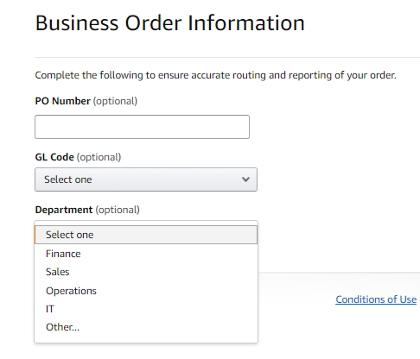
Business Order Information
Track and manage orders by setting up custom fields that display on order documentation and reports.
Business Order Information (BOI) fields are enabled at the root level of an Amazon Business account and will apply to all groups/sub-groups within the account. However, Group Level Administrators have the ability to edit or remove BOI fields for their specific groups.
Business Order Information needs to be activated at the account level by an account Admin.
All information entered will appear in Order History Reports in the Business Analytics tool.
Each field can be required or optional.
There are up to 100 options that can be pre-configured in a drop down style menu.
Available Fields
GL Code | Cost Center
Project Code | Location
Department | *Custom named field*
Purchase Order (PO)

Slide 9
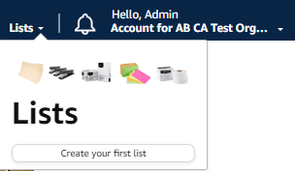
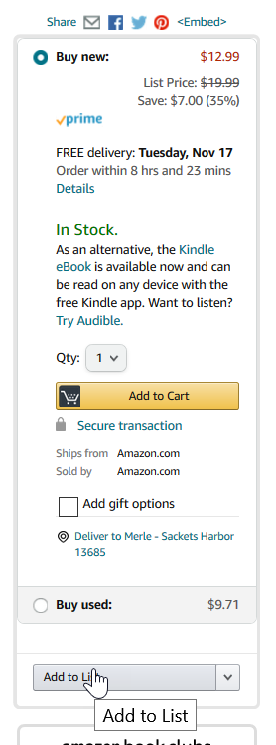
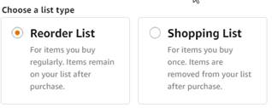
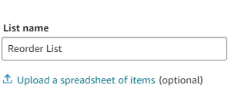
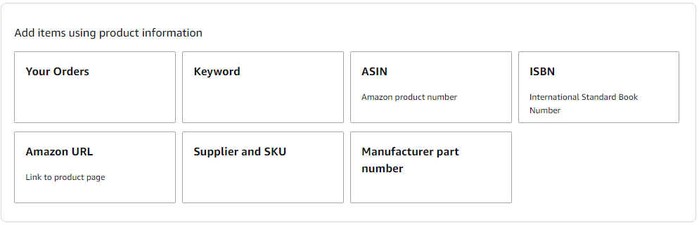
Business Lists – Creating Lists
How do lists work on Amazon Business?
Lists make it easy to keep track of the things you need and are easy to share with others. Any User on Amazon Business can create a shopping list
See Create your first list (link) for a detailed 1-pager on how to create list for future reference
Simply hover over Lists in the top right corner of the main page and click “Create a List”
Select re-order so items remain on list for future purchases
Easily upload multiple items via spreadsheet template or search/browse by key words such as ASIN, keyword, part #, and even your past orders

Slide 10
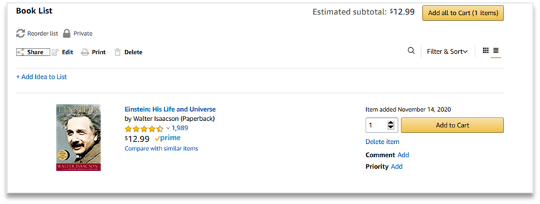
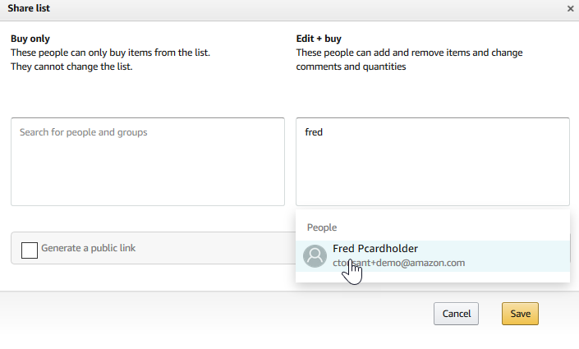
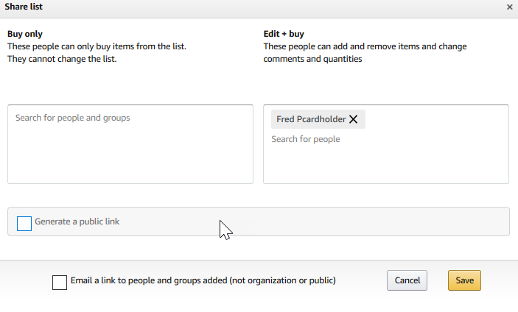
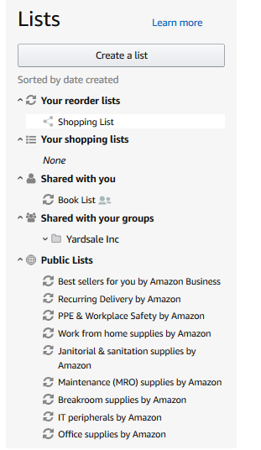
Business Lists – Sharing Lists
Sharing the list
Click “Share” to choose a user with whom you would like to share the list.
Choose whether the user will be able to edit the list and enter then enter a name in the box underneath.
Once you select the name, choose whether you want the user to receive an email notifying the user a list has been shared.
Click save and now the list appears in the selected user’s Shared with you within Lists.
Link to 1-pager on how to share/review lists:
Sharing a List
Reviewing a Shared Shopping List

Slide 11
Members
Support Videos [CLICK HERE]
User roles/Permissions video
Group management video
Adding/Removing Users video

Slide 12
User Roles & Permissions
Each user can have multiple roles -- administrator or requisitioner, or both. Permissions can be assigned when an administrator invites a user to the business. Administrators can change user permissions at any time.
Assign administrator permissions on a per-group basis. One administrator can manage multiple groups. Group level administrators only have admin authority over the group(s) they are assigned.
Role | Permissions & Functionality | Visibility
Admin | Manage business settings & business features Invite people to join the business account Remove users from the business account Assign a role to a user Set up approval workflows and spending limits Configure shared payment methods and shipping addresses Add certifications such as tax exemptions to the business account | Administrators can view orders and order history for all purchases in their group(s) on behalf of the business. Last 4 digits of any payment methods used by Requisitioners Billing & Ship to addresses All Amazon Business Analytics fields for orders placed by users in their group(s)
Buyer (requisitioner) | Place orders on behalf of the organization Add payment methods and shipping addresses at checkout *if individual pay is configured Utilize Business Analytics for their own purchases Can be configured as an Approver | Order history for all orders that they placed for their organization with their business user account Shipping addresses & payment methods (last 4 digits visible), as established by the administrator
PunchOut User | Place orders on behalf of the organization through a punchout session Add payment methods and shipping addresses at checkout *if individual pay is configured Utilize Business Analytics for their own purchases | Order history for all orders that they placed for their organization with their business user account Shipping addresses & payment methods (last 4 digits visible), as established by the administrator
Finance | Access invoices, credit notes, analytics, and order history. Access, customize, and schedule Amazon Business reports, and manage tax information.
Tech | Manage domain names, authentication methods, API keys, and IT system integrations such as purchasing systems, transaction data, and single sign-on.

Slide 13
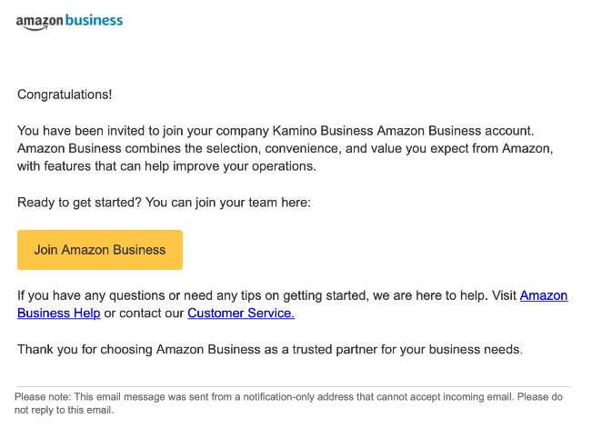
Inviting Users to Amazon Business
Administrators can add users to the account one by one or all at once by uploading a spreadsheet
How do Invitations Work?
When a user is added to the business account, an invitation to join is immediately emailed.
Invitations are tied to an end users email address. The recipient cannot change the email address they use to register for the account.
End users must take action after being invited to an account in order to become an active user.
User permissions are assigned when a user is invited.
Account invitations are valid for 90 days from send date. After 90 days, they will expire and need to be resent

Slide 14
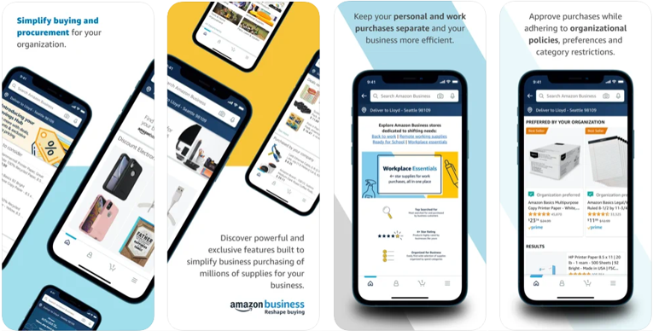
Amazon Business Mobile App
The Amazon Business app is your one-stop shop for finding and buying work supplies on the go. Amazon Business customers can now sign in to the dedicated Amazon Business mobile app, which is exclusive for business users.
Direct your purchasers to download the Amazon Business mobile app for buying on the go
We recommend users handle their first time setup/access through a desktop browser
Download the AB Mobile App (iOS App or Android App)
Get push notifications for order shipments and approvals
Enjoy a seamless purchasing experience while adhering to organizational policies and preferences all from your mobile device

Slide 15
Accessing the Account through Single Sign On
Accessing the Amazon Business account is simple for end users when Amazon is integrated with your organization’s IDP
How do end users sign in?
Depending on how users have used their work email on Amazon in the past, they may need to take action to separate or migrate an existing account.
  For those who have not used their work email in the past, they will be immediately authenticated into the central account.
  For those who do need to take action to separate out their existing account, this is a one time process. They will be authenticated automatically each subsequent time.

Slide 16
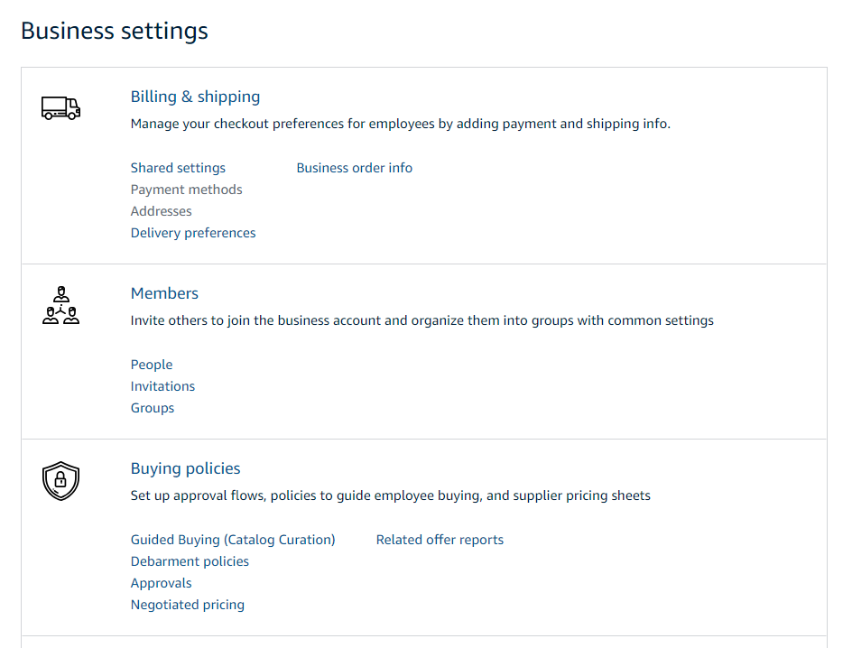
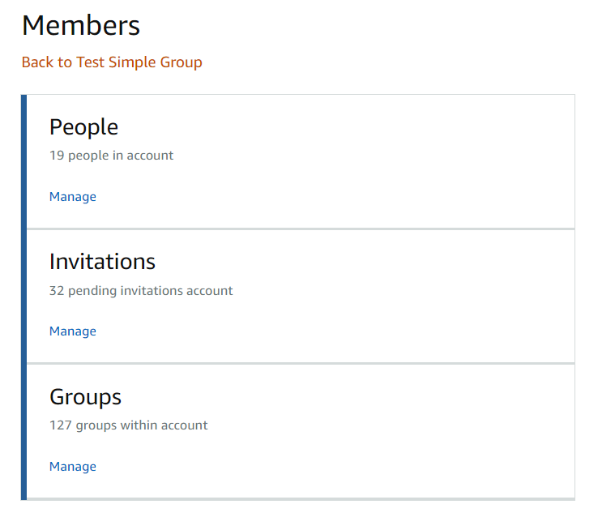
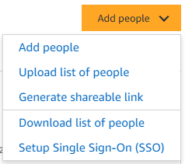
Members
Invite others to join the business account and organize them into groups with common settings
The People section of your account enables you to manage all active users on the business account. You can add and remove users, edit user roles, and download a complete list of account users from this section of your account.
The Invitations section tracks all pending and expired invitations to users. Once a user has accepted their invitation, that person will move to the People section.
To help keep your users organized, people can be added to specific Groups. Many settings such as approvals, shared payment methods, and catalog curation messages can be configured at the group level

Slide 17
Download List of Users and Pending Invitations
Invitation Status | Definition
“Expired” | The invitation has expired and an administrator must re-send a new invitation for the user to join (see this slide)
“Pending” | User is a member of an existing consumer account, and they must take action via the link sent to them in an invitation. The user will be required to “Convert” their account or “Split” personal account history (see FAQ)
“Pending Merge”** | User is a part of an existing business account, and they must take action via the link sent to them. This process will de-register their existing Business Account and allow them to merge into the official business account, maintaining purchase history.
“Merge Deferred”** | User has indicated they do not want to merge their existing business account into the official account.
Blank (the cell is empty) | The user is ACTIVE and a member of the indicated group(s). For automatically created accounts, the user may not have set their password yet. In this case, the user must follow password reset instructions (see FAQ).
Invitation URL can be sent directly to invitee to activate their login

Slide 18
Buying Policies
Support Videos [CLICK HERE]
Guided buying Overview video
Configure guided buying video
Configure spend limits / approval workflow video
Reviewing approval requests/process video

Slide 19

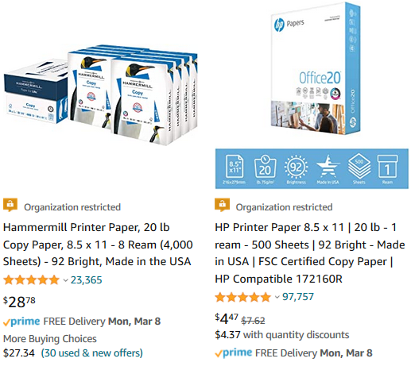
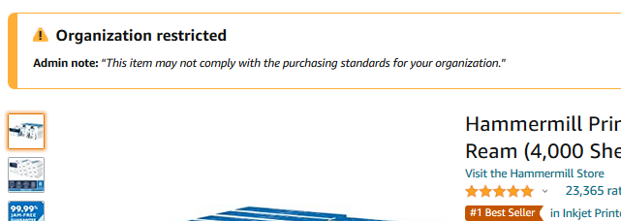
Restricted Policies
Administrators can customize messaging to let end users know IF and WHEN they can purchase certain UNSPSC based categories on Amazon Business
Restricted products will be clearly marked throughout the buying process
Purchases with Restricted items may require additional approval
Administrators have direct visibility into any restricted purchases via Business Analytics
Notes:
--Remove if GB not in scope--

Slide 20
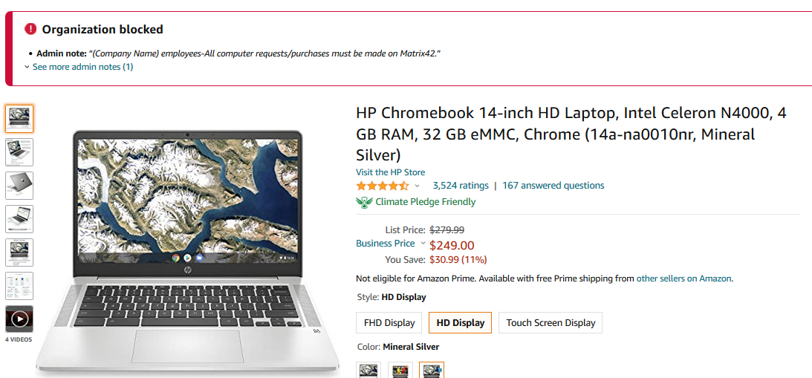
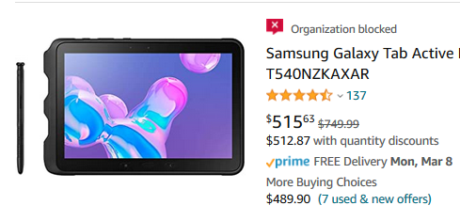
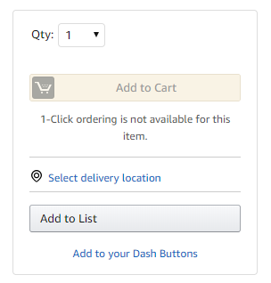
Blocked Policies
Hard blocking product categories prevents an end user from adding these product to their cart. The add to cart option will appear greyed out for any product categories that are blocked
Please contact IT for laptop acquisition.
Blocked products will be clearly marked throughout the buying process
Blocked products cannot be added to cart, the cart will be grayed out
Notes:
--Remove if GB not in scope--

Slide 21

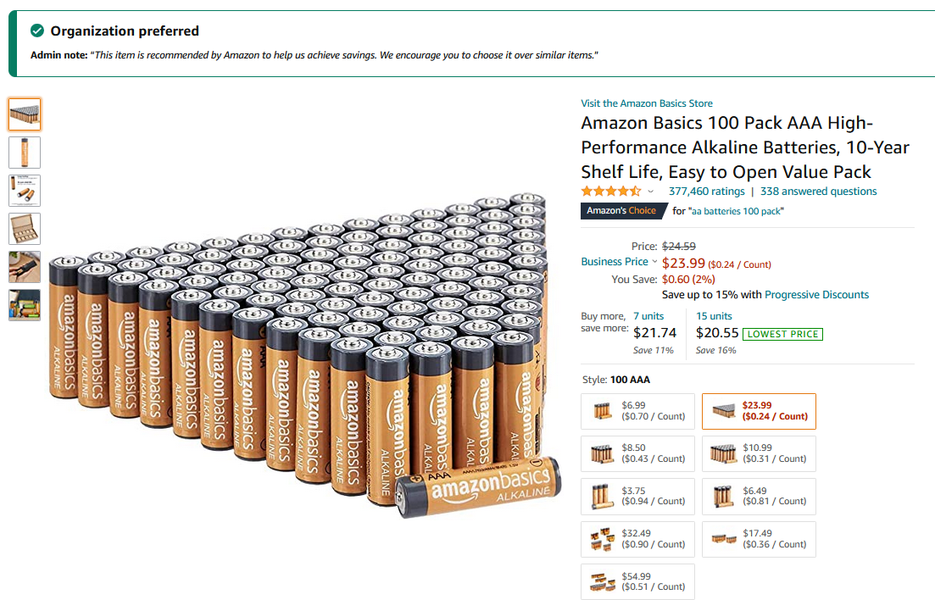
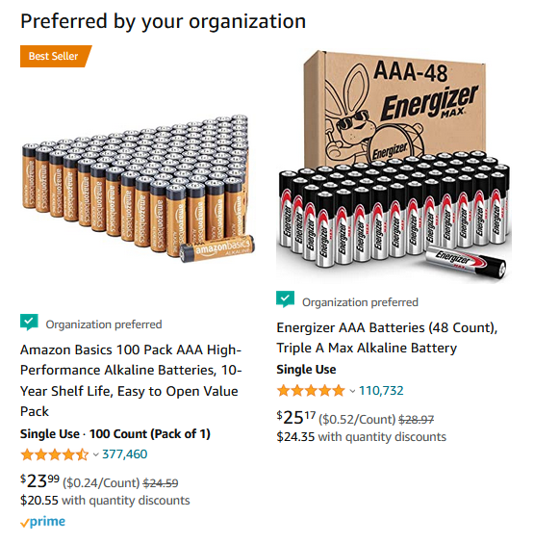
Preferred Products/Sellers
Mark specific products as preferred to ensure your end users can easily find what they are looking for. This messaging is visible throughout the shopping experience, search results, and on product detail pages.
Preferred products will be clearly marked throughout the buying process
Notes:
--Remove if GB not in scope--

Slide 22
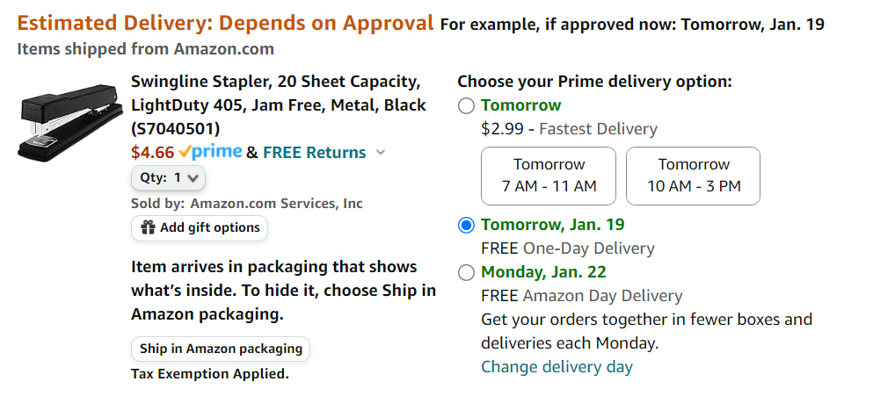
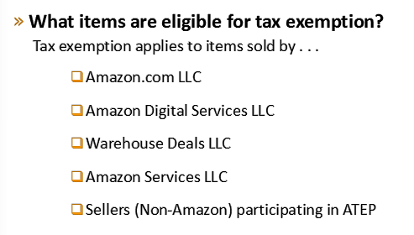
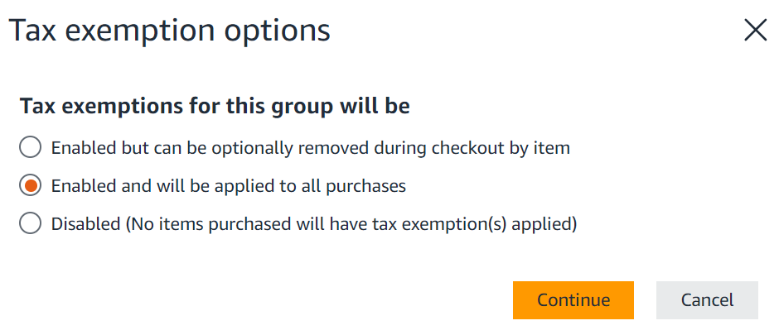
Tax Exemption Application & Checkout
Amazon is responsible for all tax collection, remittance and refunds for orders placed on Amazon.com and exemption will be displayed at checkout
Confirm tax exemptions are applied:
Admins can choose how tax exemptions will be applied to orders upon tax exemption set up.
The ability for users to remove tax exemption per line item in checkout is enabled by default. Admins can update these settings under Tax Exemption > Manage Permissions.
On the Review Your Order page (checkout), verify and/or modify which items should be charged sales tax.
Admins are notified 30 days prior to their exemption expiring (when applicable), encouraging them to upload their new exemption to prevent a lapse in coverage.
Notes:
-

Slide 23
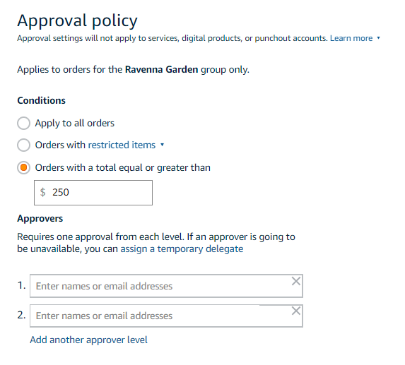
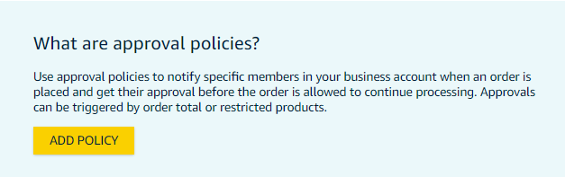
Approvals
Approval workflows provide visibility and control over purchasing
Administrators can configure up to 6 levels of approvals. Each level of approval can have more than one approver. Only one approval is needed at each level.
Approvers are notified of pending orders through email as well as when they log into their Amazon Business account.
Requisitioners or Administrators can be designated as approvers.
Only active account users can be configured as approvers.
Approvals can be set up at individual group levels by navigating to Buying policies > Approvals and then further customized for individual users.

Slide 24
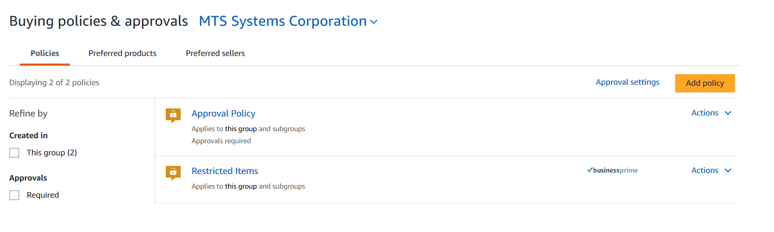
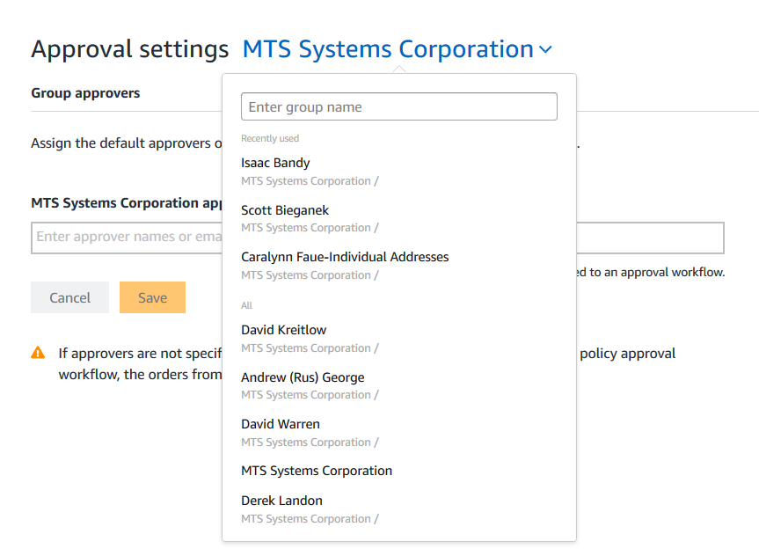
Editing Approval Workflows with ’Group Approver’
To change a group’s existing ‘group approver’ or to add a new group approver, go to Buying policies & approvals (under Business Settings) > Approval Settings. Then navigate to the group you want to edit using the drop down menu. From that group’s page you can edit that specific group’s ‘group approver’.
Company Name
Group 1
Group 2

Slide 25
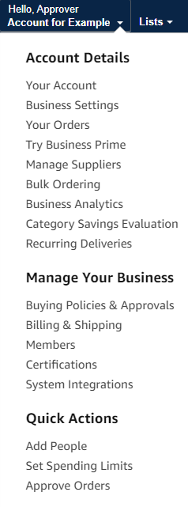
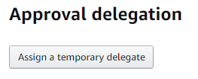

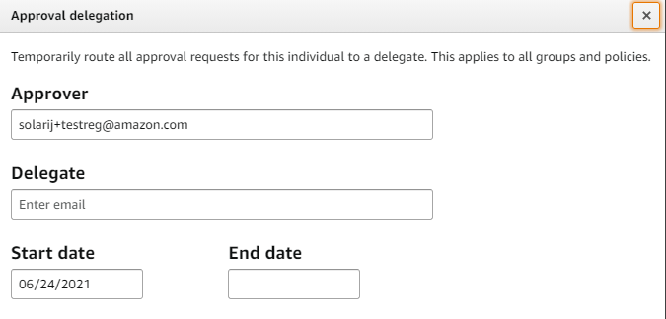
Assigning an Approval Delegate
An administrator can assign an approval delegate for time periods where that primary approver will be out of the office or unable to approve orders.
Notes:
Admins can also assign a delegate by navigating to Business Settings> Approval settings > Assign delegates (Next to Approver Unavailable?)

Slide 26
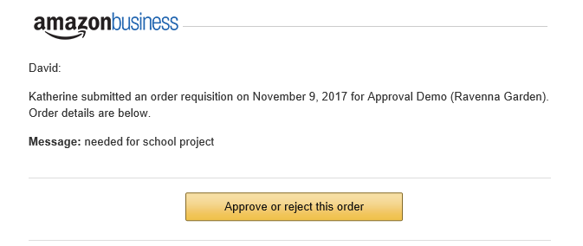
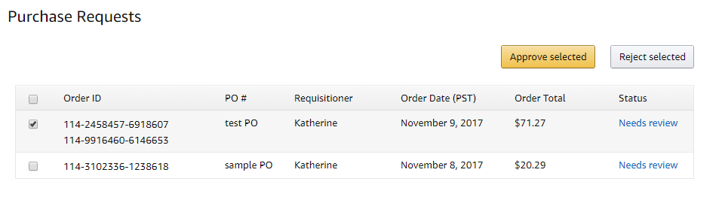
Approving Orders
Any time an order is routed to you for approval, you will get an email notifying you of the request. Purchase requests can be approved directly from the email or by navigating to Approve Orders in the top right drop down of your account.
Once a purchase is submitted for approval, the order is held for 7 days. Approval requests that take longer than 7 days will be rejected
If you have multiple orders awaiting approval, you have the option to approve or reject them in bulk
    Any time you reject an order, you can send comments back to the requisitioner explaining why the order was rejected
    When an order is approved, an order confirmation email is sent to the requisitioner letting them know that their order was approved and is now being processed by Amazon

Slide 27
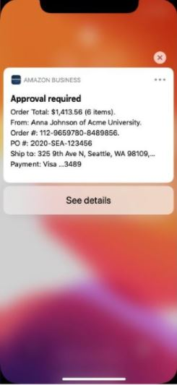
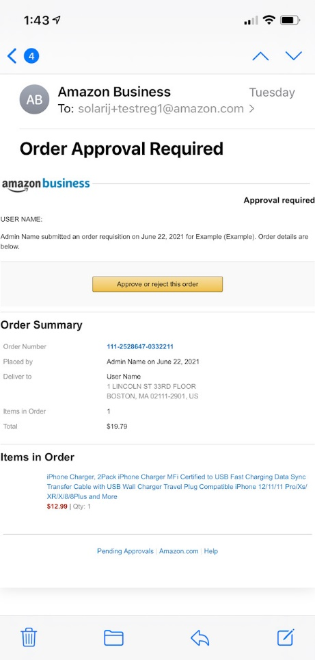
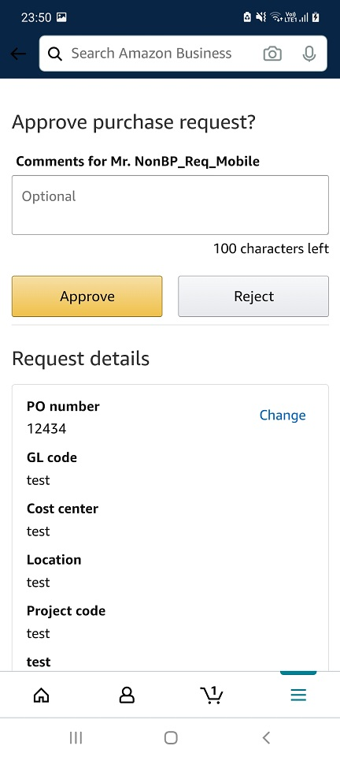
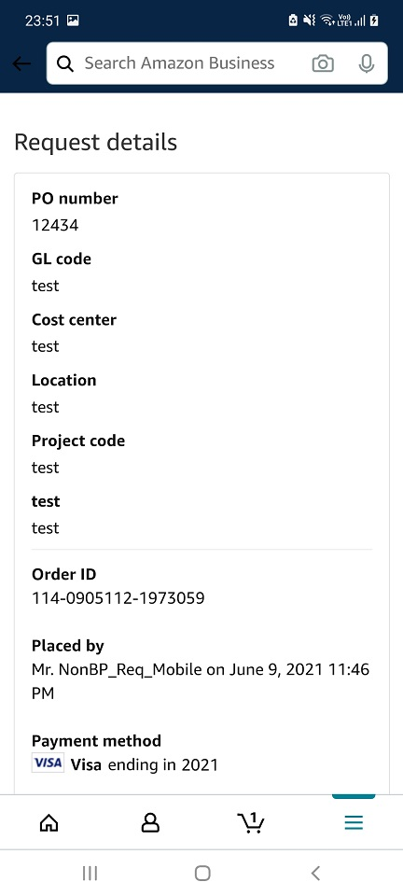
Approving Orders On the Go
Purchase requests can be approved directly from your mobile device with the Amazon Business Mobile App.
When an approver has the Amazon Business Mobile App installed on their mobile device and a user places an order with an approval policy required, the approver will get an email notifying them of the request as well as a push notification on their device.
The approval can be actioned from the push notification or the email.

Slide 28
Business Analytics & Spend Visibility

Slide 29
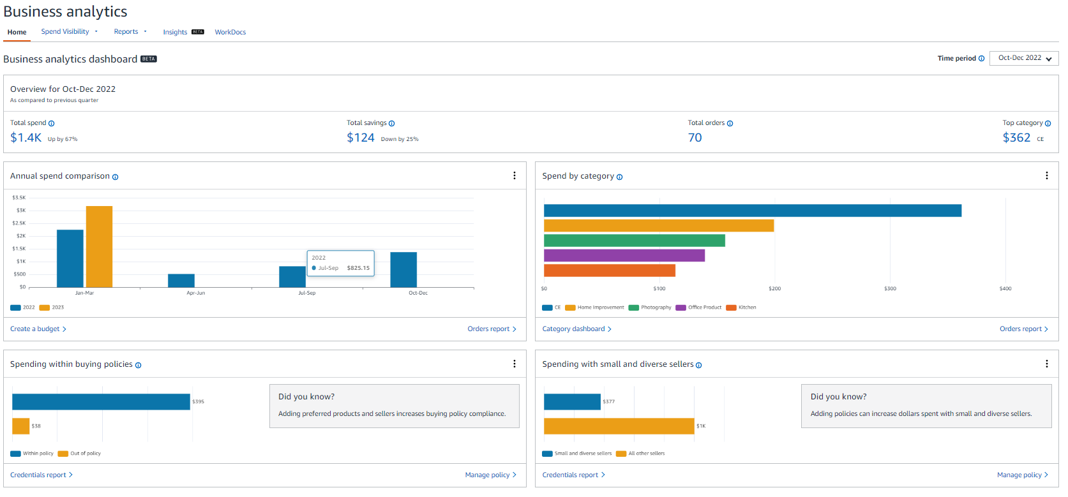

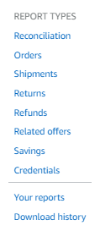
Amazon Business Analytics
Business Analytics offers eight default reporting options to choose from depending on your reporting needs.
Amazon Business Analytics provides the ability to:
Aggregate purchases to compare and track spend over time
Monitor and track 60+ data fields including customer info, shipment info, payment info, and seller info
Customize and save report templates to meet business needs
Download CSV files to analyze your data in excel
Resources:
Download order documentation and invoices from Business Analytics
Amazon Business Analytics Glossary of Terms
Notes:
There are 8 default reports available in Business Analytics
Order Report
Reconciliation Report
Shipments Report
Returns Report
Refund Report
Related Offers Report
Savings Report
Credentials Report
Reports can be used as-is or customized using the Filters and Adjust Columns pane.
In the interest of time, this presentation will focus on the 2 most interesting and ProServ relevant reports and provide a customer use case for each

Slide 30
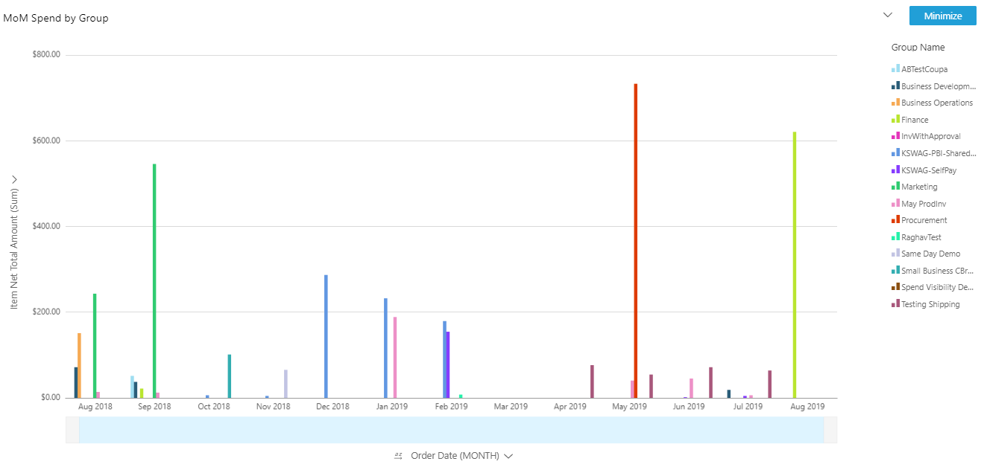
Spend Visibility
Visualizations that can help make smart budgeting decisions:
Procurement Dashboards
Policy Adherence Dashboards
Compliance Dashboards
Shipping Cost Savings Snapshot
Tailor visualizations to meet your procurement goals
Supplemental Links and Info:
Spend Visibility Users and Roles
Access Spend Visibility Dashboards
Filter Spend Visibility Dashboards

Slide 31
Your Orders

Slide 32
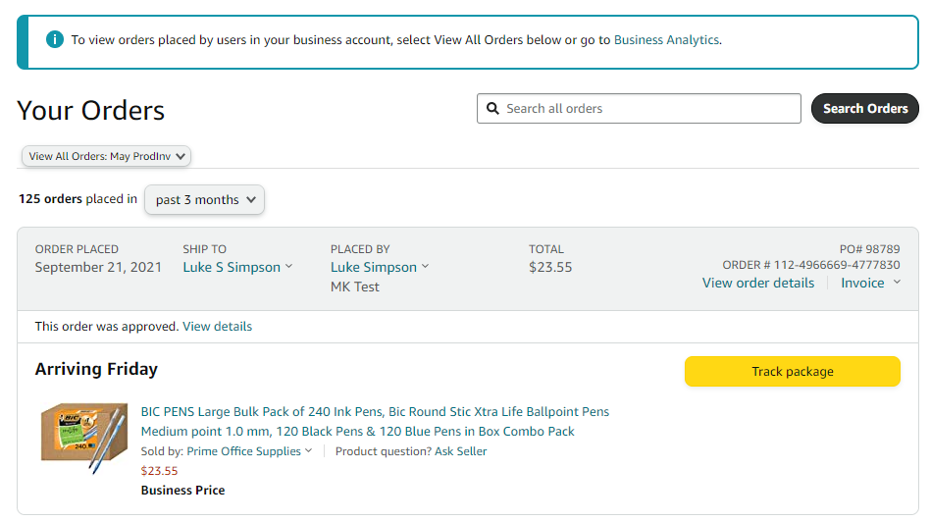



Your Orders
This section of the account provides additional detail regarding the status of all orders that have been placed within the Business Account. You will also use this page to Return of Replace Items on behalf of your buyers
As an Admin ensure you select “view all orders” to see every order in the account

Slide 33
Business Customer Support

Slide 34

Business Customer Support
Dedicated U.S. based Business Customer Support can be reached a number of ways including email, chat and phone. Not sure what you’re looking for? Learn more about the features and benefits on Amazon Business HERE. Call 866-486-2360.
Notes:
Your users should be instructed to reach out to Customer Service for any order, shipping, refund related questions”

Slide 35
Supplemental Documentation

Slide 36



How To Guides and Helpful Videos
Self Service Resources
Training Videos
Release Notes

Slide 37


Common Amazon Business Support Questions
Quick resolutions to frequently asked questions and contact information for a variety of support resources
Contact Business Customer Support: CLICK HERE or call 866-486-2360
  Provides end users the option to call, email, or live chat. Please use this method of contact for anything relating to an order, transaction, charge, or shipment.
Support when Joining the Account: CLICK HERE or call (833) 972-6630
  Provides end users the option to contact a dedicated support team for assistance with end user registration issues.
Cancel an Individual Prime Membership:
  Your Account > Manage My Prime Membership > End Membership
  The end user must follow the steps to receive a pro-rated refund.
Request a Tax Exemption Refund:
  Request a tax refund or ask other tax related questions by sending an email to tax-exempt@amazon.com
Notes:
Due to Marketplace Facilitator Legislation, Amazon is charge of all tax collection, remittance and refunds for orders placed on Amazon.com. Items sold by Amazon subisidiaries (Zappos, 6PM) may be subject to tax depending on the customer exemption. (Ex. Resale). If an organization has a tax exemption correctly loaded onto their account, the only reason they would still be charged tax on an item because it is an item sold by an Amazon subisidiary (ie Zappos, 6PM)

