Slide 1


Amazon Business Approver Training
Amanda Issa – Customer Success Manager (Amazon)
Corey Holyoak (Millard School District)

Slide 2
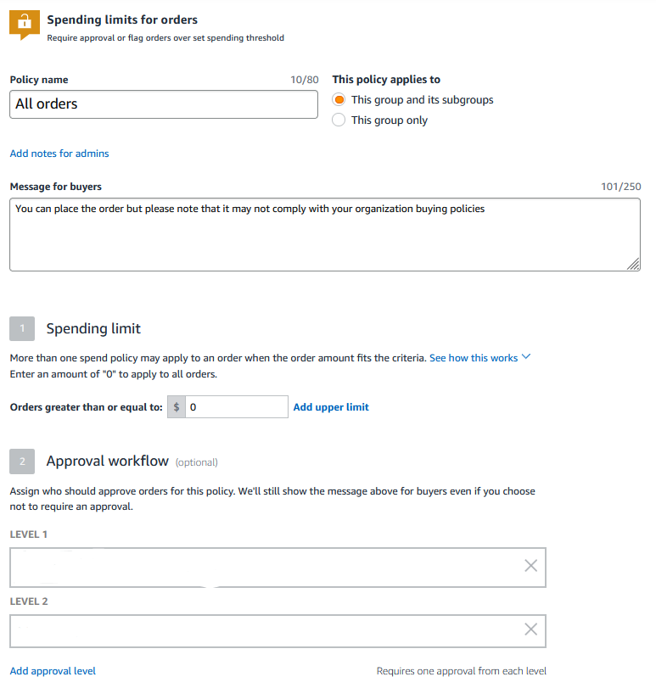
Approval Policies
Approval workflows provide visibility and control over purchasing
Each level of approval can have more than one approver. Only one approval is needed at each level.
Approvers are notified of pending orders through email as well as when they log into their Amazon Business account.
Only active account users can be configured as approvers.
Notes:
Approvals are created by administrators on the account to provide visibility and control over purchasing. They set the policy guidelines, dollar threshold, levels of approvers and who those approvers will be.
Each level of approval, up to 6 levels, can have more than one approver, but only one person needs to approve the order at each level.
Approvers are notified of pending orders through email as well as when they log into their Amazon Business Account
Only active account users can be configured as approvers.

Slide 3
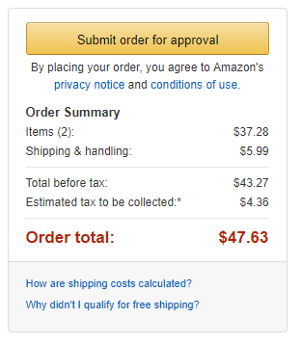
Approval Workflow – User Experience
Orders placed on the account are subject to approval before being fulfilled
How do I order with Approvals configured?
There are no additional steps to take to submit your order for approval. Check out as you normally would and you will see the option at checkout. As an approver, you will not have to approve your own orders despite selecting Submit order for approval at checkout.
Your order will not be processed until it is approved by the appropriate approver. Keep this in mind for shipping timelines. You will be notified over email once your order is submitted and then again once your order has been approved and processed. Just as with a normal order on Amazon, you will also receive relevant shipping updates.
If your order is not approved within 7 days, the order will automatically be canceled; however, the items in your order will not be deleted. If your order is canceled, you will need to submit the order again for approval.
Notes:
Orders placed on the account are subject to approval before being fulfilled
There are no additional steps to take to submit an order for approval. Check out as normal and you will see the option at checkout to Submit order for approval. As an approver, you will not have to approve your own orders despite selecting Submit order for approval at checkout. The system will circumvent the approval workflow for orders placed by approvers but it can cause confusion as you may still receive a notification saying the order was submitted for approval. Additionally orders can show up as pending approval sometimes if there is a lag in the system.
Orders will not be processed until it is approved by the appropriate approver. Keep this in mind for shipping timelines. Buyers will be notified over email once their order is submitted and then again once the order has been approved and processed. Just as with a normal order on Amazon, they will also receive relevant shipping updates.
If the order is not approved within 7 days, the order will automatically be canceled; however, the items in the order will not be deleted. If the order is canceled, they buyer will need to submit the order again for approval.

Slide 4
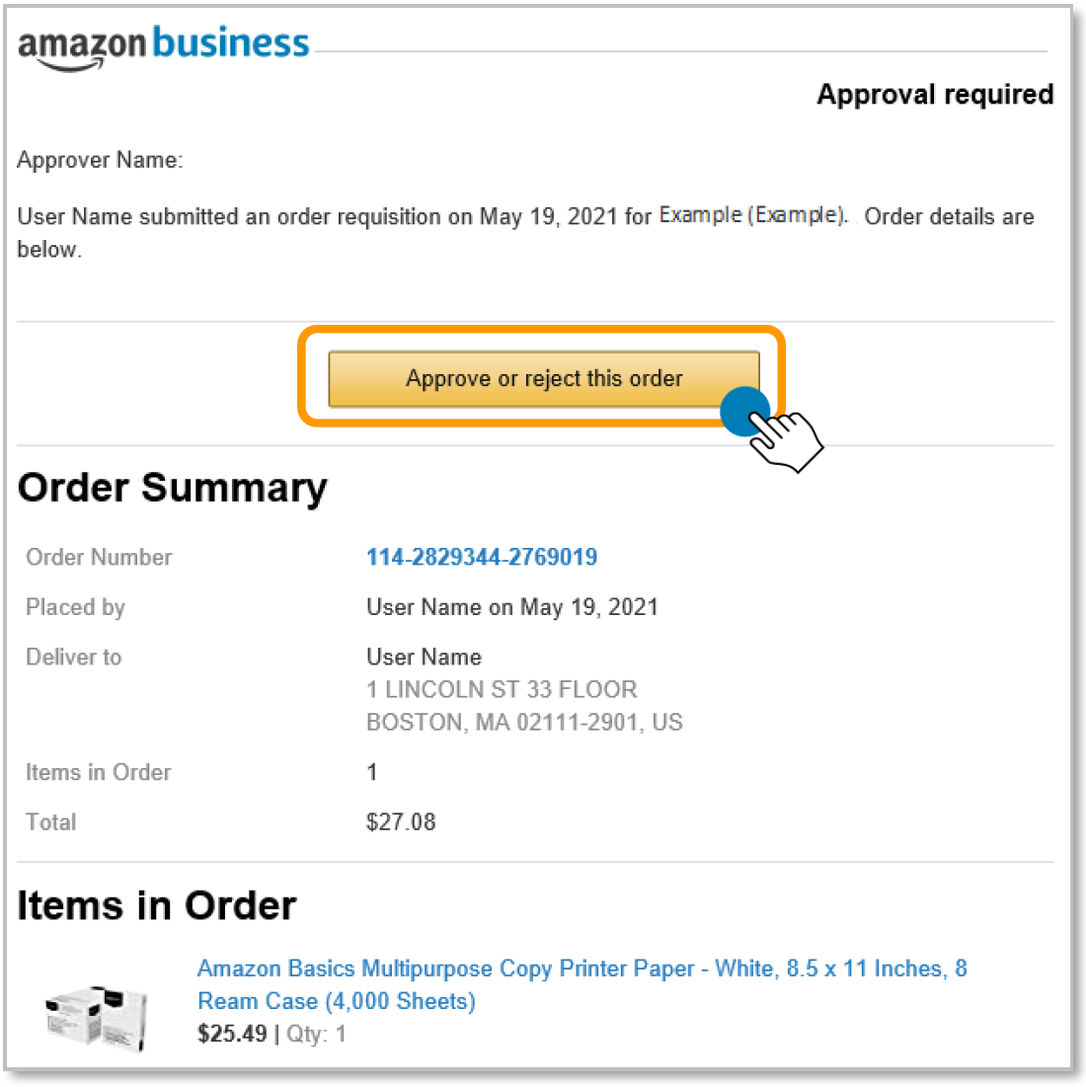

Approving an Order
When a user places an order with an approval policy required, the approver will get an email notifying them of the request.
Once a purchase is submitted for approval, the order is held for 7 days. Approval requests that are not completed within 7 days will be rejected
Notes:
When a user places an order with an approval policy required, the approver will get an email notifying them of the request.
By clicking on the “Approver or reject this order” button in the email, you will be directed to your Amazon Business account to complete the approval process.
Once a purchase is submitted for approval, the order is held for 7 days. Approval requests that are not completed within 7 days will be rejected.

Slide 5
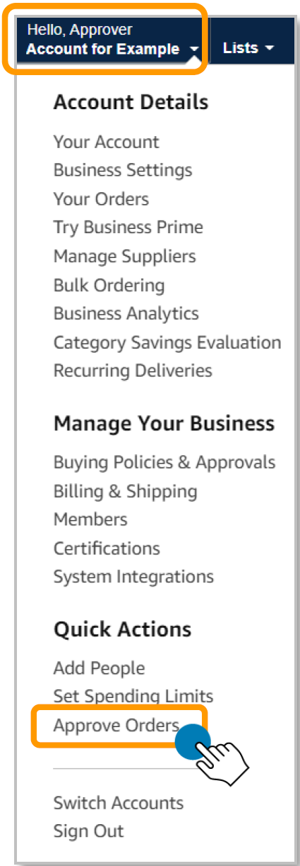
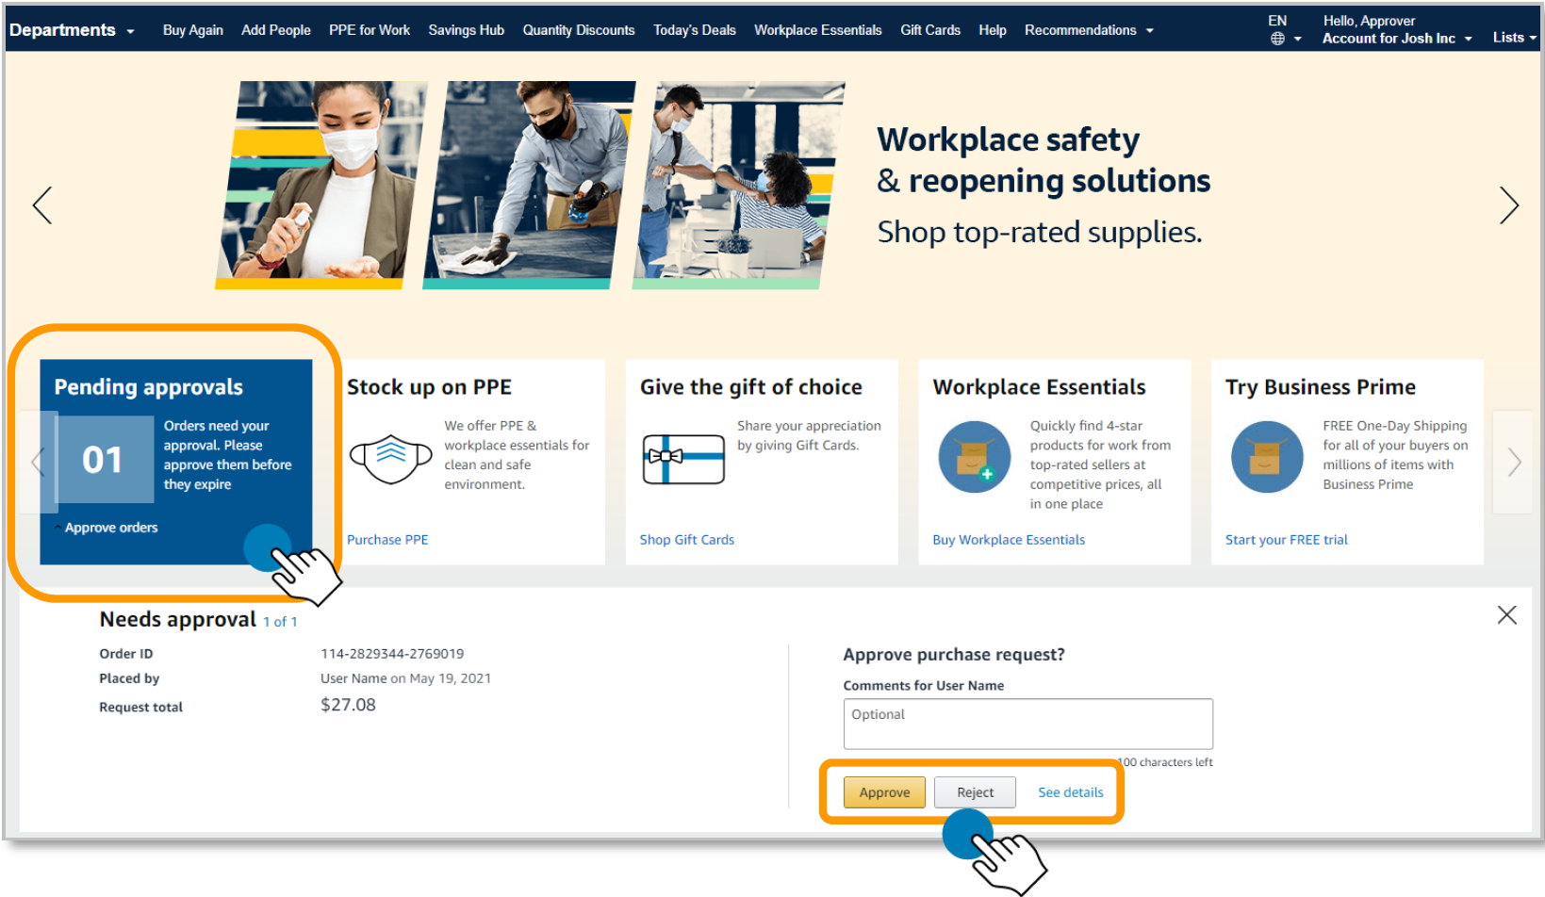
Approving Orders
Purchase requests can be approved directly from the email or by navigating to Approve Orders in the top right drop down of your account.
Notes:
Purchase requests can be approved directly from the email, from the front page on Amazon Business by clicking the blue box “Pending Approvals” or by navigating to Approve Orders in the top right drop down of your account.

Slide 6
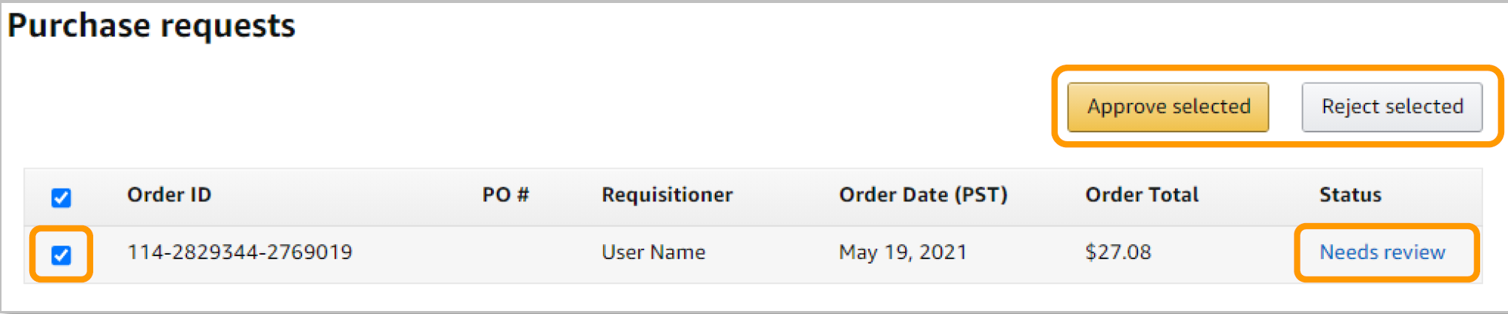
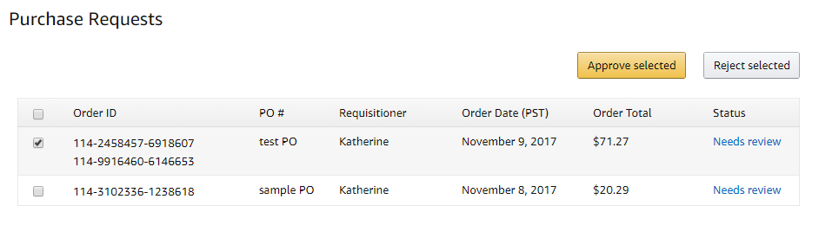
Purchase Requests Page
The Purchase requests page allows you to review orders that have been submitted for approval.
You can select the check box on the left hand side of the order and Approve selected or Reject selected order(s) from this page.
If you wish to review the order in further detail, you can select Needs Review.
If you have multiple orders awaiting approval, you have the option to approve or reject them in bulk
Notes:
The Purchase requests page allows you to review orders that have been submitted for approval.
You can select the check box on the left hand side of the order and Approve selected or Reject selected order(s) from this page.
If you wish to review the order in further detail, you can select Needs Review.
If you have multiple orders awaiting approval, you have the option to approve or reject them in bulk

Slide 7
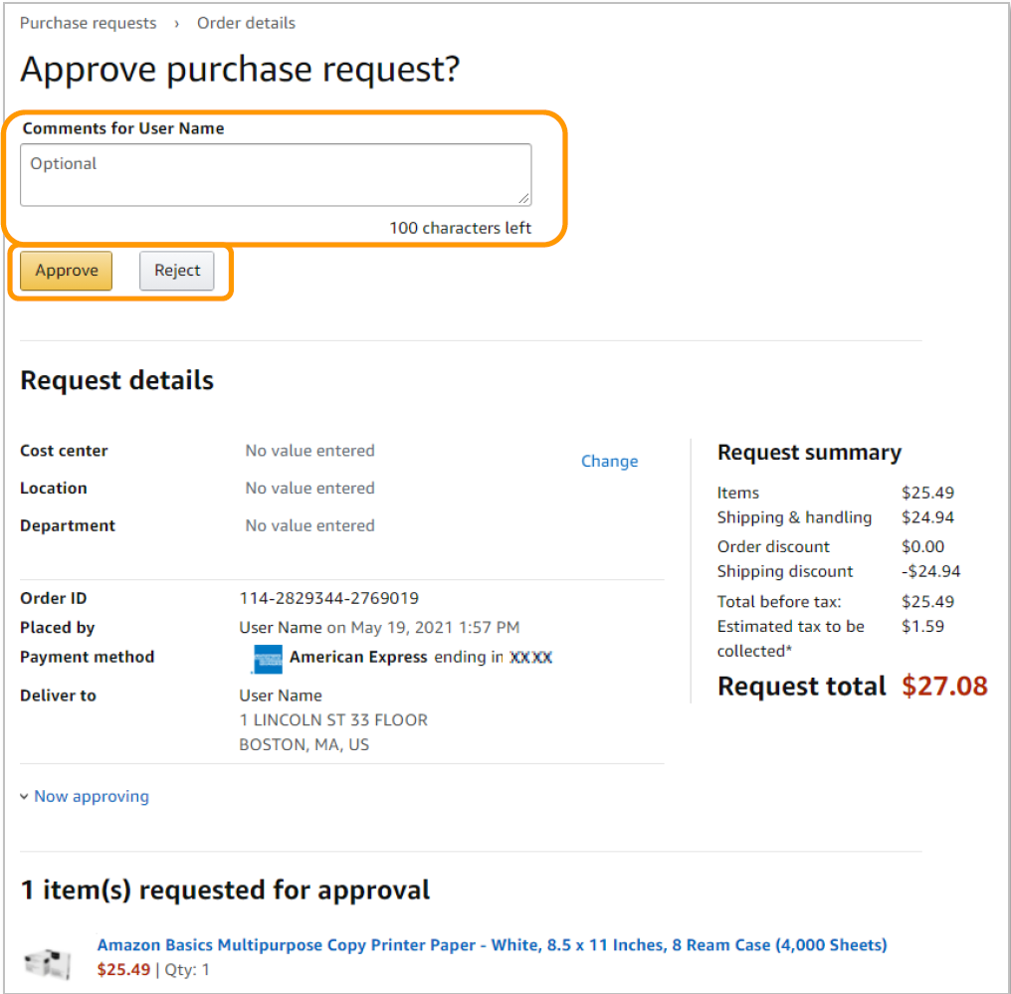
Approve/Reject
Review order details and Approve or Reject the order. You are also able to include comments on the reasoning for order approval or rejection for the user to review.
PO Number
Notes:
Review order details and Approve or Reject the order. You are also able to include comments on the reasoning for order approval or rejection for the user to review.
If your organization has required specific remittance details such as purchase order or cost center, review the Request Details for accuracy. You can amend the details by clicking Change correcting the information

Slide 8
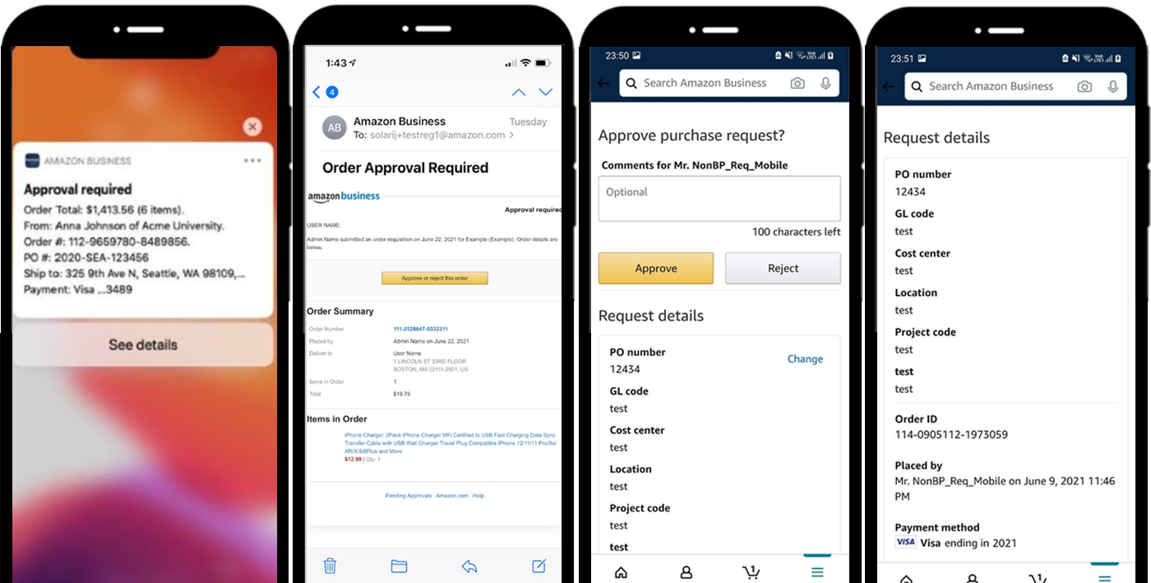

Approving Orders On the Go
Purchase requests can be approved directly from your mobile device with the Amazon Business Mobile App.
When an approver has the Amazon Business Mobile App installed on their mobile device and a user places an order with an approval policy required, the approver will get an email notifying them of the request as well as a push notification on their device.
The approval can be actioned from the push notification or the email.
Notes:
Downloading the Amazon Business Mobile app allows you to approve directly from your phone. When an order is placed requiring an approval, you will receive a push notification on your phone. Clicking on the notification or accessing the email from your phone will allow you to complete the approval process directly from your mobile device.

Slide 9
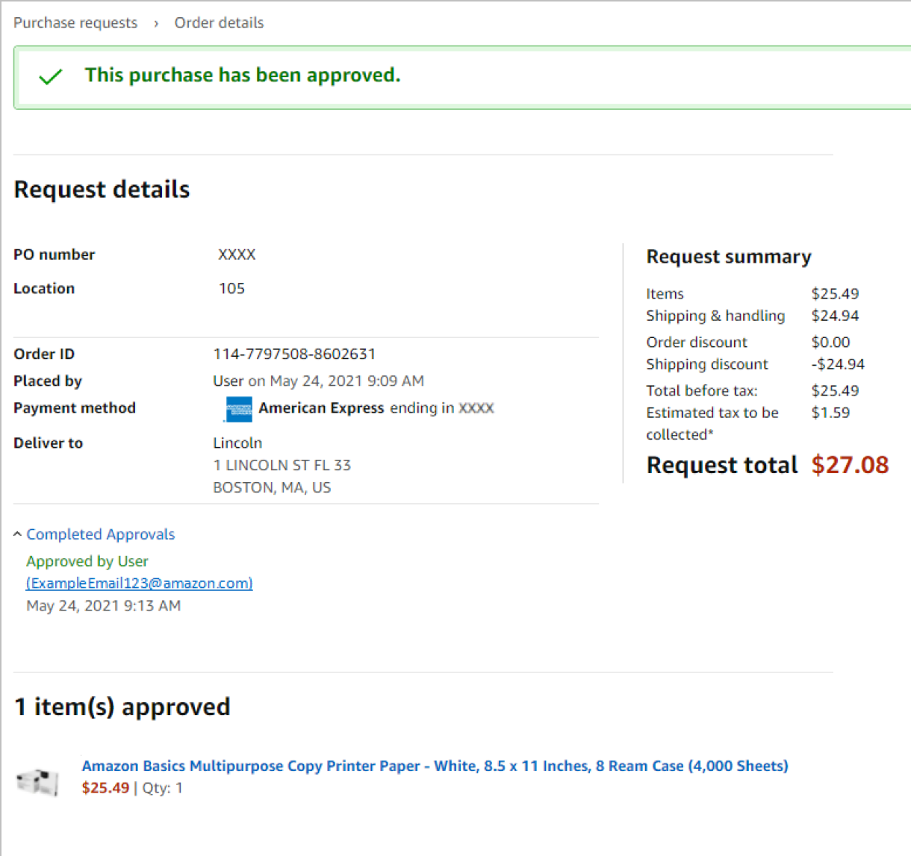
Email Confirmation
Once an order is approved or rejected, you will receive a confirmation and the order requestor will also be notified via email.
Notes:
Once an order is approved or rejected, you will receive a confirmation and the order requestor will also be notified via email.

Slide 10
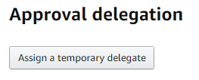

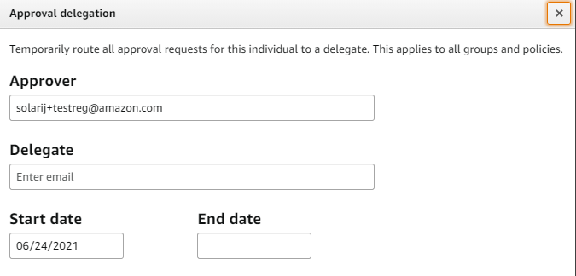
Assign an Approval Delegate
An approver can assign an approval delegate for time periods where that primary approver will be out of the office or unable to approve orders.
Navigate to your approval queue by selecting Approve Orders from the drop down menu in the top right hand corner of your homepage.
Click Assign a temporary delegate.
Enter approval delegate’s email address and the start and end date for the approval delegation to be applied and save.
Start date is recommended 3-5 days before Approver is out.
Notes:
An approver can assign an approval delegate for time periods where that primary approver will be out of the office or unable to approve orders.
Navigate to your approval queue by selecting Approve Orders from the drop down menu in the top right hand corner of your homepage.
Click Assign a temporary delegate.
Enter approval delegate’s email address and the start and end date for the approval delegation to be applied and save. The delegate must be active on the Amazon Business account.
Start date is recommended 3-5 days before Approver is out to ensure the delegate is receiving the approval notifications and is comfortable with the process.

Slide 11
Business Customer Support

Slide 12
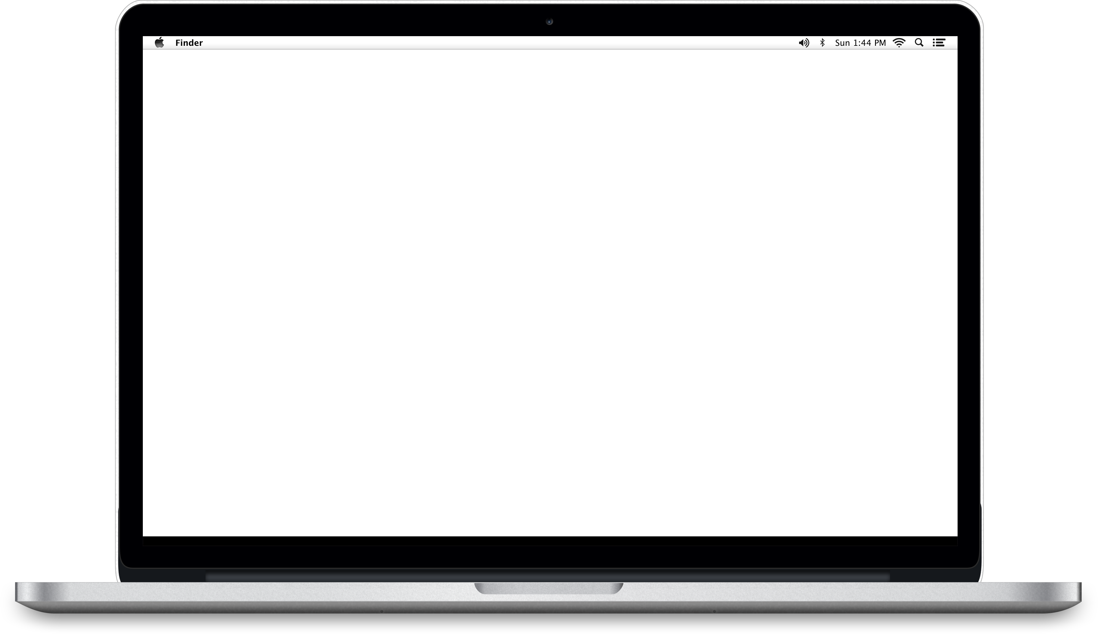
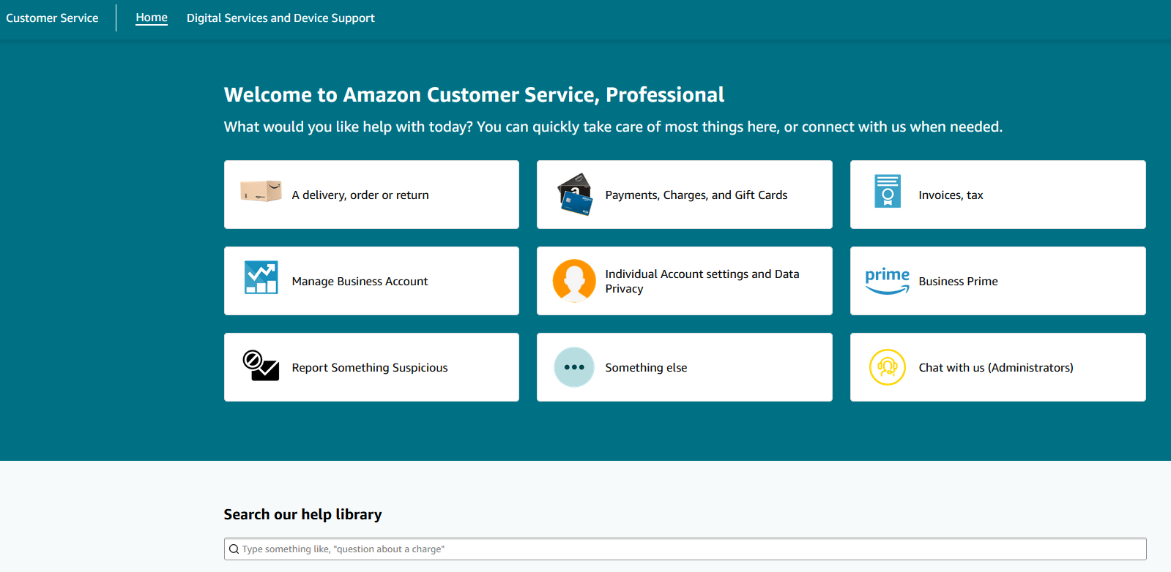

Amazon Business Customer Support
Dedicated Business Customer Support can be reached a number of ways including email, chat and phone. Not sure what you’re looking for? Learn more about the features and benefits on Amazon Business HERE. Call 866.486.2360 or use Chat or Email on the Amazon Business Account.
Notes:
Dedicated Business Customer Support can be reached for any order, shipping, or refund related questions in a number of ways including email, chat and phone. They are available 24/7, so feel free to reach out at anytime.
Scroll to the bottom of any Amazon Business page to the “Let Us Help You” section
Select Customer Support to start an email or Contact Us to start a chat or a phone call.

Slide 13

Thank You

